Slide 1
FHIR is Awesome!
Your Name
March 17-18, 2015

Slide 2
Introduction
Notes:
Time start-10:00 (10 minutes)

Slide 3
Who am I?
Name: John Smith
Company: Acme Inc
Background:
Why you’re such a know-it-all
Picture here
If you can

Slide 4
Credit where it’s due
This presentation is licensed under the Creative Commons “attribution” license (so take and use as you see fit)
A large part of the content comes from slides originally developed by Ewout Kramer, Grahame Grieve, Lloyd McKenzie & others
So if it’s wrong, blame them ☺

Slide 5
Attendees
Who is your organization?
What is your role?
HL7 (v2/v3/CDA) background?
How did you hear about FHIR?
How familiar are you with FHIR?
What is the one thing that will make the next two days most valuable for you?
Time allowing

Slide 6
Objectives
What will they learn and be able to do?

Slide 7
Section 1

Slide 8
Right-click beside slide and choose “layout” to see other options

Slide 9
Conclusion

Slide 10


Next Steps for you
Attend other FHIR tutorials
Developers, Profiles, Deep Dive
Read the spec: http://hl7.org/fhir
Comment in the discussion areas
Follow #FHIR on Twitter
Shape the specification:
Join the FHIR track at this WGM
Feedback – discussion, tracker, list server
Try implementing it
Come to a Connectathon!

Slide 11
Education opportunities
Attend a Working Group Meeting
Tutorials, Connectathons
May 8-14 Paris
October 2-9 Atlanta
Attend an Implementation Workshop
Intensive tutorials, hands-on
This week
July 13-15 DC
November 16-18 Dallas
FHIR Institute Webinars
April 20-24 (Covers Day 1 from this implementation workshop)
Update this

Slide 12
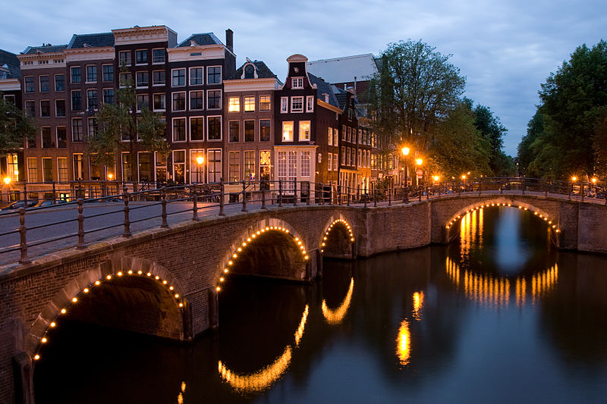





International HL7 FHIR Developer Days November 18-20, 2015 in Amsterdam
Education
14 tutorials
pick & choose
Connectathon
Meet fellow developers
Put FHIR to the test
Networking
FHIR experts and authors on hand
http://fhir.furore.com/devdays
Un-hide if relevant

Slide 13
QUESTIONS?
Your email here
Notes:
Don’t forget your evaluations!

